Slide 1

V i b e I t
Our Music Playlists
Search
Home
Library
Music App!
Presented By:
Harshita Chourasiya

Slide 2

Where words fail
Music Speaks….

Slide 3
Table of contents
01
02
03
04
INTRODUCTION
HTML
CSS
JAVASCRIPT

Slide 4
INTRODUCTION
Search
As streaming is increasingly being adopted by users, online media players have become essential for consuming media on the internet. Music players allow one to enjoy music in any browser and supports a lot of the features of an offline music player.
I will be creating a music player with a clean user interface that can be used to play music in the browser.
I will start by creating the HTML layout first that defines the structure of the player, make it look good by styling using CSS and then write the player logic for all the functions in JavaScript.
Home
Library

Slide 5
HTML
The HTML layout defines the element structure that would be shown on the page. The player can be divided into the following portions:
Details Portion:
This section shows the details of the current track being played. It includes the track number, track album, track name and track artist.
Buttons Portion:
This section shows the buttons that are used to control the playback of the track. It includes the play/pause button, the previous and next track buttons. They would have an onclick() method that calls a specific function defined in the JavaScript file.

Slide 6
HTML
Sliders Portion:
This section contains the seek slider and volume slider that can be used to control the playback and volume.

Slide 7
CSS STYLING
Cascading Style Sheets (CSS) is a stylesheet language used to describe the presentation of a document written in HTML or XML. CSS describes how elements should be rendered on screen, on paper, in speech, or on other media.
There are three types of CSS which are given below:
Inline CSS
Internal or Embedded CSS
External CSS

Slide 8
JAVASCRIPT
JavaScript is a lightweight, interpreted programming language. It is designed for creating network-centric applications. It is complimentary to and integrated with Java. JavaScript is very easy to implement because it is integrated with HTML. It is open and cross-platform.
JavaScript helps you create really beautiful and crazy fast websites. You can develop your website with a console like look and feel and give your users the best Graphical User Experience.

Slide 9
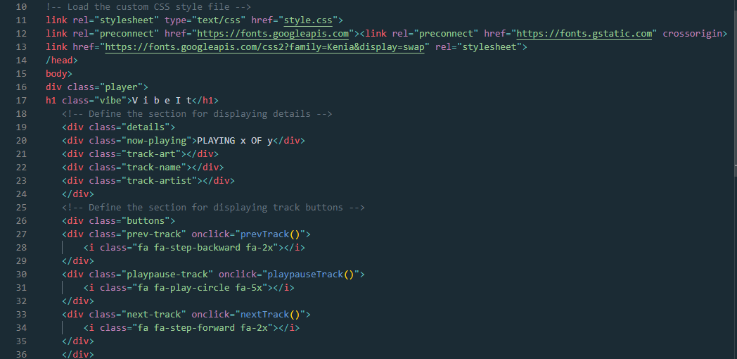
HTML CODE

Slide 10
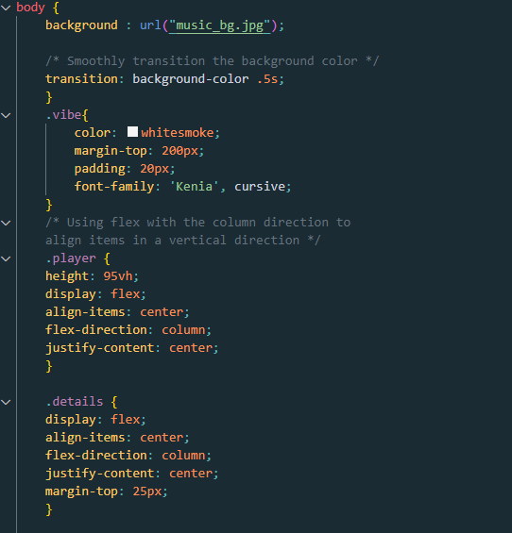
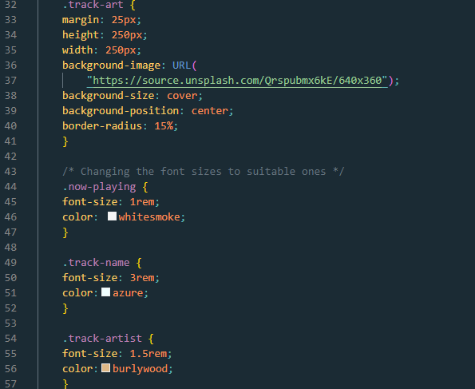
CSS STYLING

Slide 11
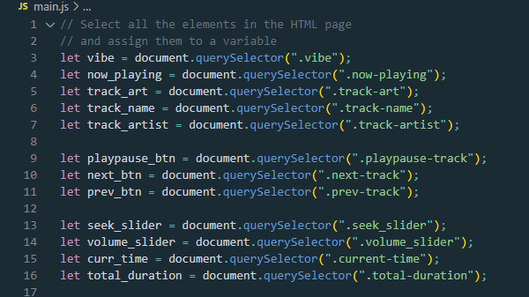
JAVASCRIPT
Search
Home
Library

Slide 12
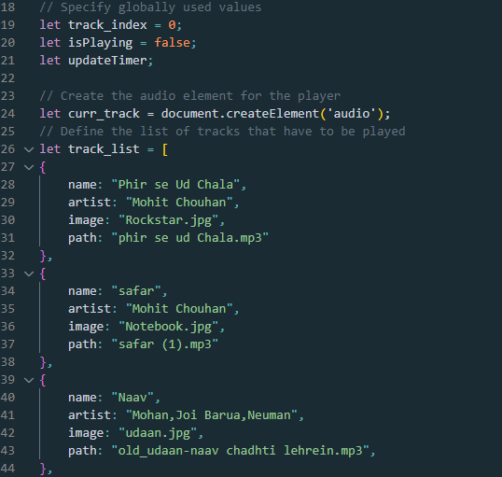
JAVASCRIPT
Search
Home
Library

Slide 13
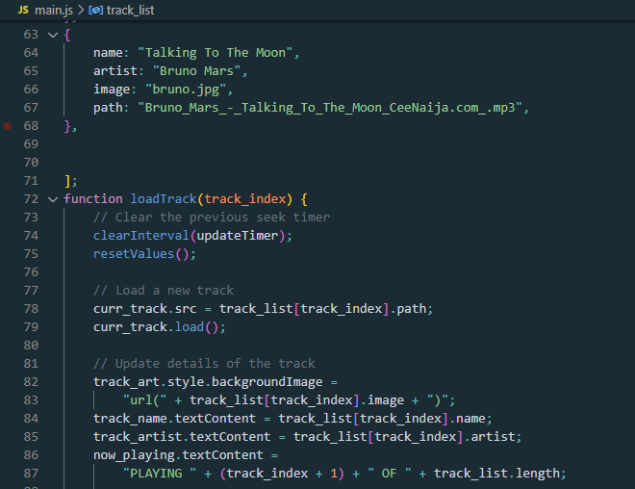
JAVASCRIPT
Search
Home
Library

Slide 14
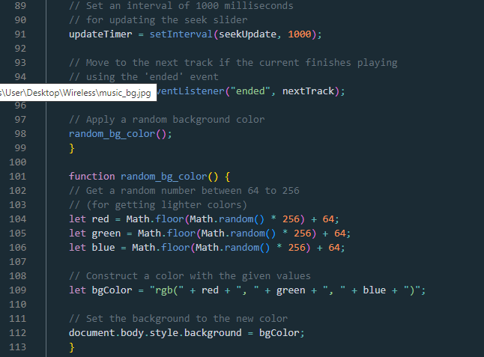
JAVASCRIPT
Search
Home
Library

Slide 15
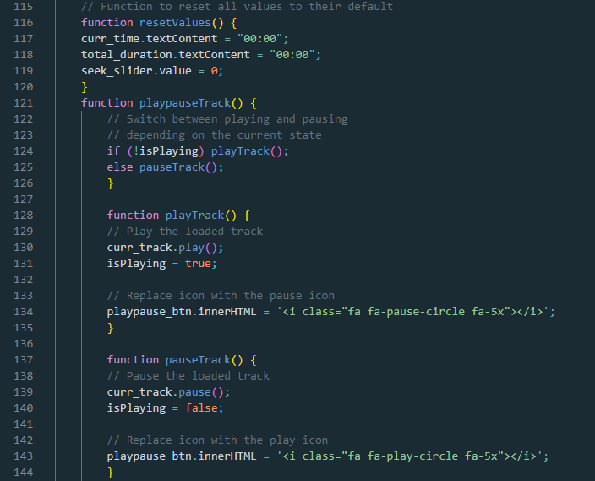
JAVASCRIPT
Search
Home
Library

Slide 16
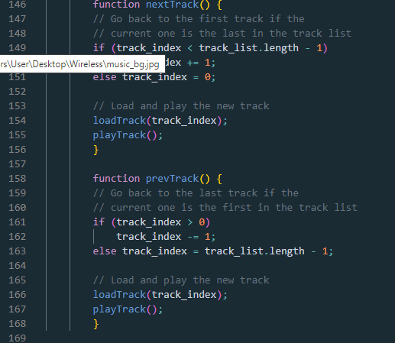
JAVASCRIPT
Search
Home
Library

Slide 17
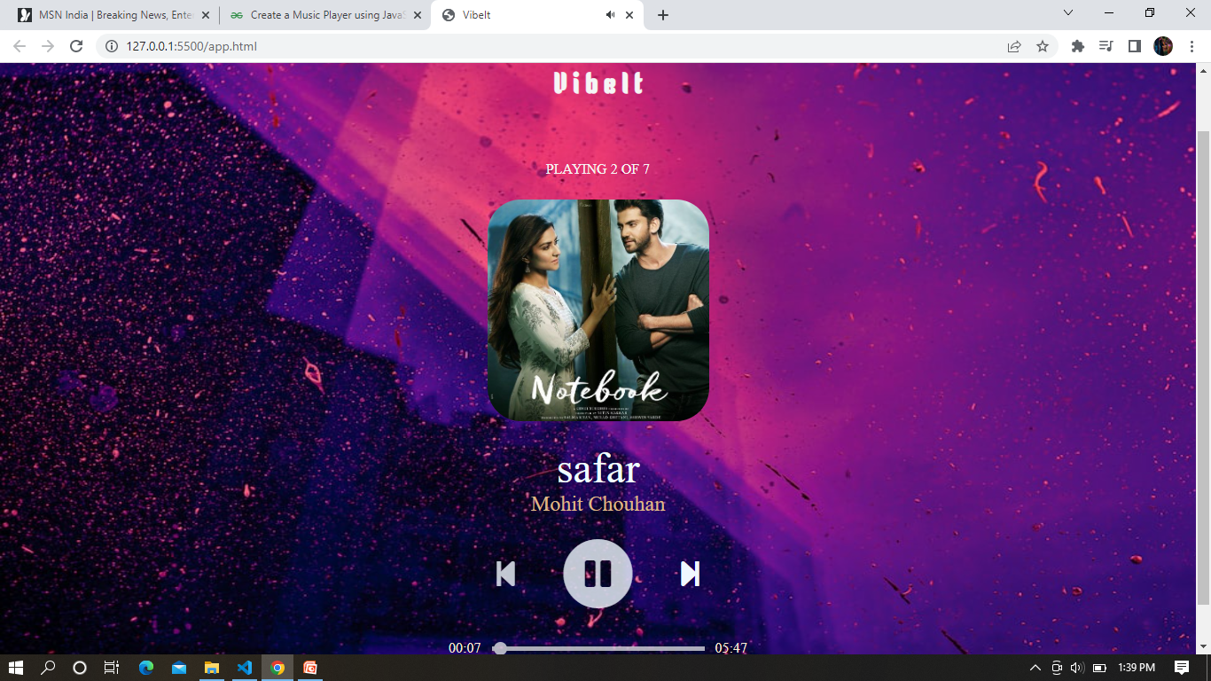
OUTPUT
Search
Home
Library

Slide 18
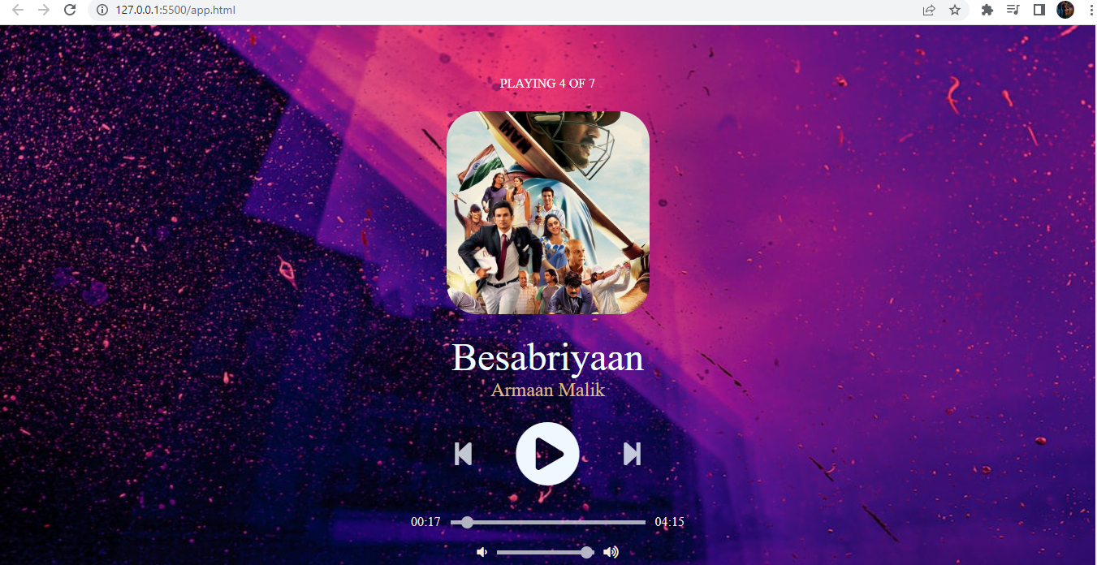
OUTPUT
Search
Home
Library

Slide 19
THANK YOU
Search
Home
Library

